Slide 1


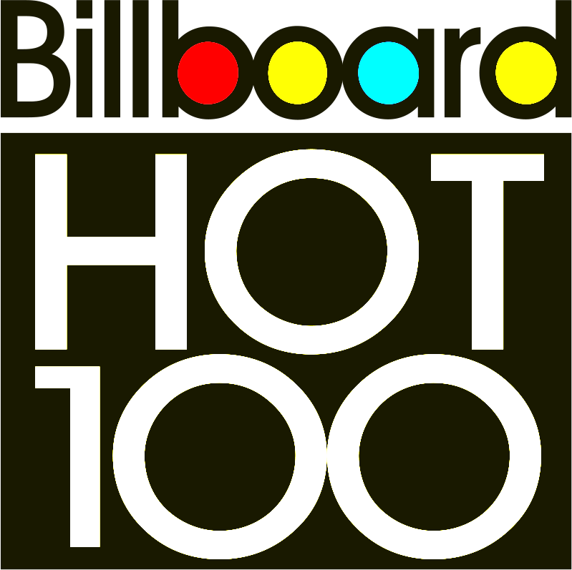
Song Popularity
ThePhoto by PhotoAuthor is licensed under CCYYSA.
Exploring how genres, artists and songs have been ranked as most popular or most listened to from 1958 to 2024 compared to other Music Critic and companies.
Presented By:
Adam Raffel
Ariana Breckenridge
Jared Pavilik

Slide 2
How are the list generated?
Statistical analysis

Slide 3
What are the most popular decades on each list?
Statistical Analysis

Slide 4
How do the most popular songs rank on these charts?
Statistical Analysis

Slide 5
What are the most popular artist?
Statistical analysis

Slide 7

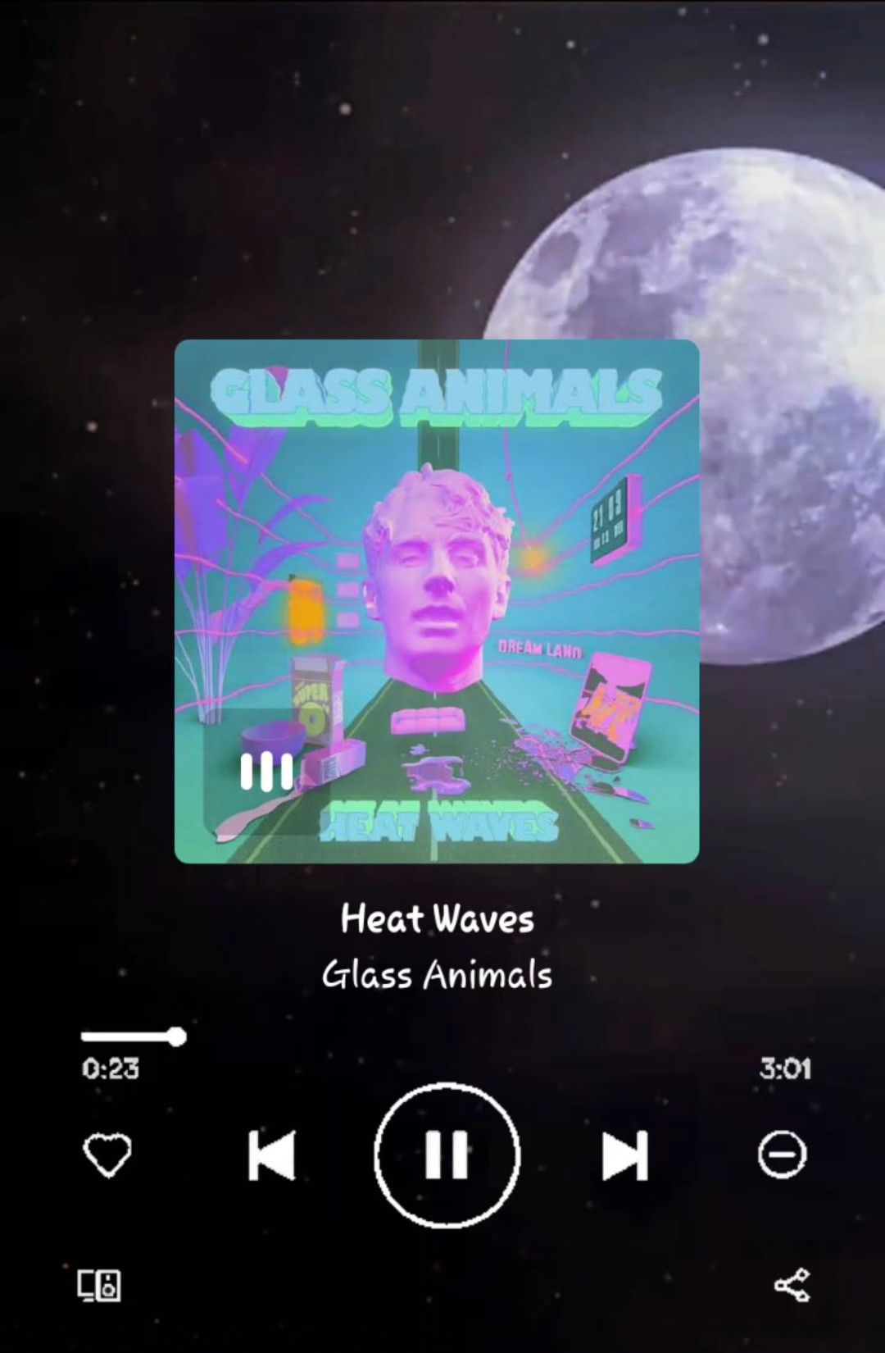

The most popular song:
Heat Wave by Glass Animals

Slide 8
resources
https://github.com/HipsterVizNinja/random-data/tree/main/Music/hot-100
https://data.world/kcmillersean/billboard-hot-100-1958-2017
https://github.com/HipsterVizNinja/random-data/tree/main/Music/rs-500
https://www.usatoday.com/story/entertainment/music/2022/01/26/heat-waves-glass-animals-dave-bayley-interview/9214768002/ --(cait moran)

